Slide 1
STARTING OUT RIGHT
Use these slides to motivate your students with inspirational quotes. Add your own favorites as well.

Slide 2
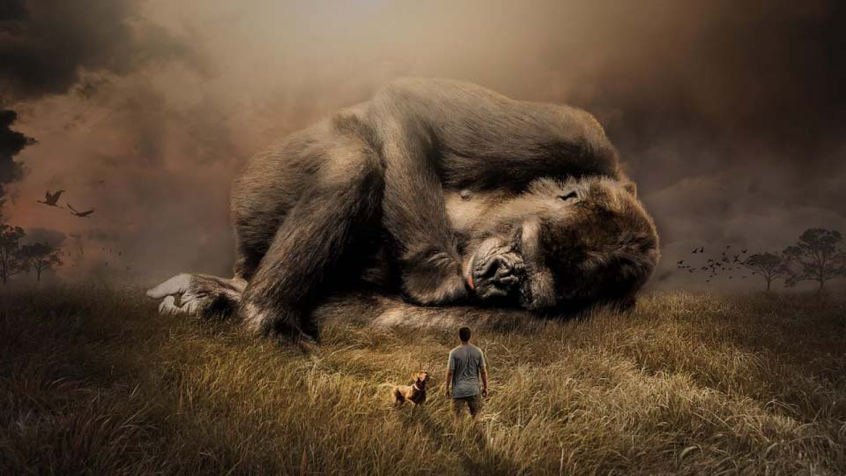
BE THE CHANGE you want to see IN THE WORLD.
Mahatma Gandhi – Civil Rights Activist

Slide 3

水滴石穿，绳锯木断 WATER DROPS PIERCE STONE; ROPE SAWS CUT WOOD.
Chinese Saying

Slide 4

There is not a particle of life which does not bear Poetry within it.
Gustav Flaubert – French Novelist

Slide 5

Write what should NOT be forgotten.
Isabel Allende – Chilean Author

Slide 6

Surely something resides in this heart that is not perishable and life is more than a dream.
Mary Wollstonecraft – British Philosopher & Feminist

Slide 7

Sometimes dreams .
are wiser than waking.
Black Elk – Oglala Sioux Medicine Man

Slide 8

We can only see a SHORT distance ahead, but we can see PLENTY there that needs to be done.
Alan Turing – British Computer Scientist

Slide 9

If you are always trying to be normal, you will never know how AMAZING you can be.
Maya Angelou – American Poet

Slide 10
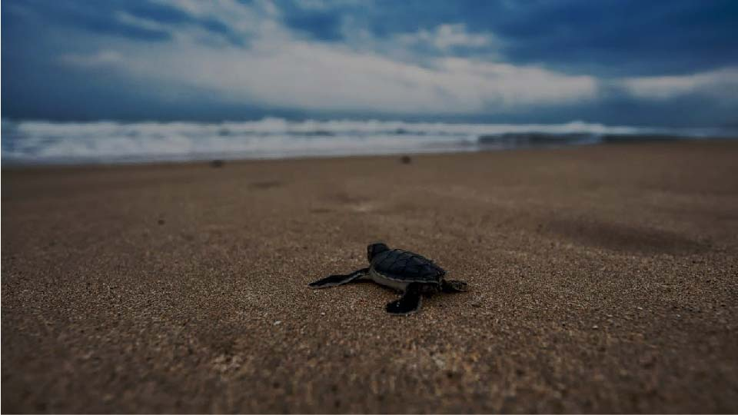
If you can't fly, then RUN. If you can't run, then WALK. If you can't walk, then CRAWL. But whatever you do, YOU HAVE TO KEEP MOVING.
Martin Luther King, Jr. – Civil Rights Activist and Pastor

Slide 11
<ADD YOUR QUOTE HERE>
Notes:
1- Insert Picture >> Format >> Send to Back
2- Add Quote >> Add Author/Writer >> Adjust text to suit image

Slide 12
Customize this Template
Template Editing Instructions and Feedback

